Slide 1
Roulette Terminal App (T1A3)

Slide 2
Roulette Terminal Application
Wanted to create a basic roulette type game.
The game is similar to roulette, where you can bet on ‘even’, ‘odd’, ‘red’, ‘black’, or any number from 0 to 36 inclusive.
The payout rules are 18 to 1 if the number lands on the number that you bet on. All other bets pay out 1 to 1.

Slide 3
Features
There are a total of nine features in this application. These are:-
The navigation menu.
The enter funds feature.
The choose what to bet on feature.
The bet amount feature.
Generate random number feature.
Display win amount feature.
Play feature.
Add result history feature.
View result history feature.

Slide 4
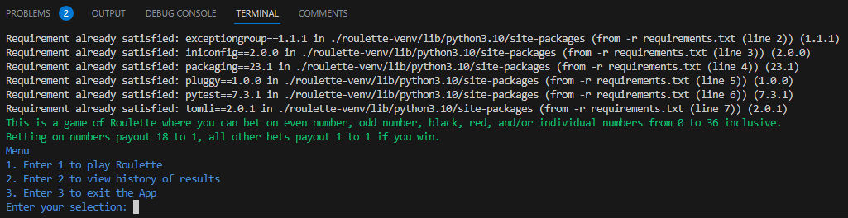
Navigation Menu Feature
You are given three options to start with, type '1' to play roulette, '2' to view the history of results, and '3' to exit the application.

Slide 5
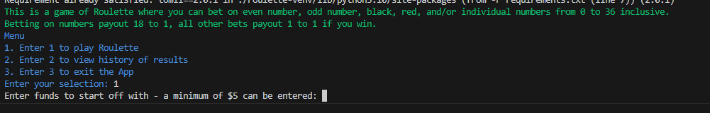
Enter Funds Feature
This feature allows the user to enter funds at the start of the game.
A minimum of $5 can be entered, as bets are a minimum of $5.

Slide 6
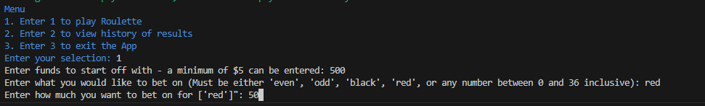
Choose what to bet on and bet amount feature
The choose what to bet on feature lets the user choose what to bet on and appends it to a list data structure.
The bet amount feature lets the user enter the amount they wish to bet on what they have chosen.

Slide 7
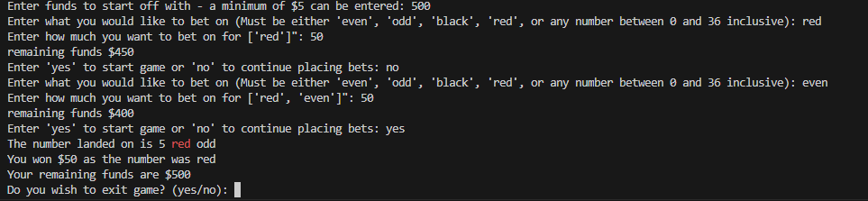
Generate random number feature
This feature generates a random number and displays the number landed on and if it is red or black and even or odd.

Slide 8
Display win amount feature
Displays the amount won if you won in the game, and the remaining funds.

Slide 9
Play feature
The play feature essentially controls the flow of the game.
There are multiple conditional statements like ‘do you want to continue betting or start game?’, and ‘do you wish to exit game?’, etc.

Slide 10
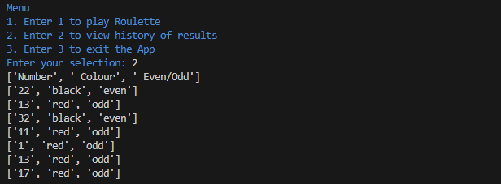
Add and View history feature
After generating the random number, the application adds the results to a ‘history.csv’ file.
You can view the result history in the main navigation menu by entering ‘2’.

Slide 11
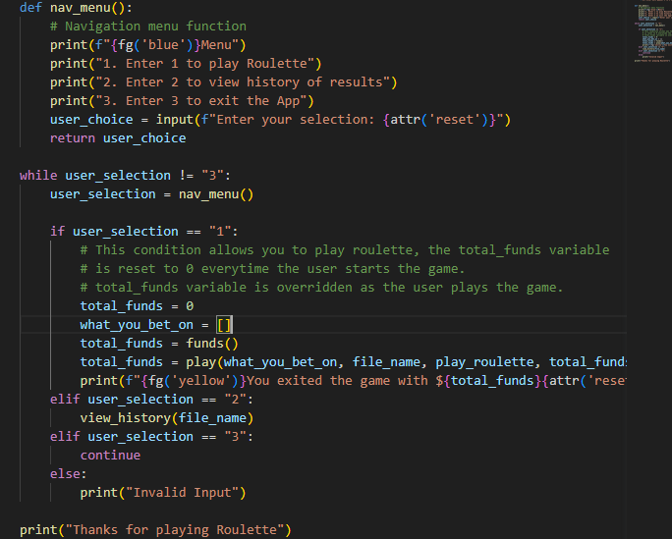
Main.py file
This file contains the code necessary to run the application.
The most important part of this file is the navigation menu code. I declared two local variables in the ‘if conditional’ – ‘total_funds’ and ‘what_you_bet_on’.
I reassigned the ‘total_funds’ variable as I wanted to display the remaining funds after exiting the game.

Slide 12
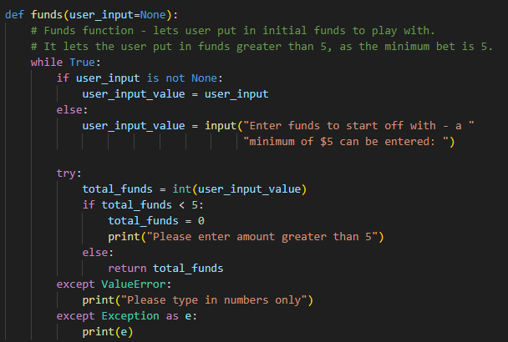
Funds() function
Used a while loop to ask the user to enter funds of minimum $5. If the user enters less than 5, it asks the user again until they enter a valid input.

Slide 13
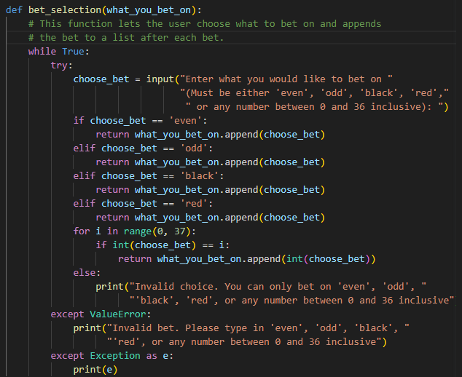
Bet_selection() function
Uses a while loop set to True.
Uses input() method to ask user to enter what to bet on, and appends to a list if the bet is valid.
Catches any errors like ‘ValueError’

Slide 14
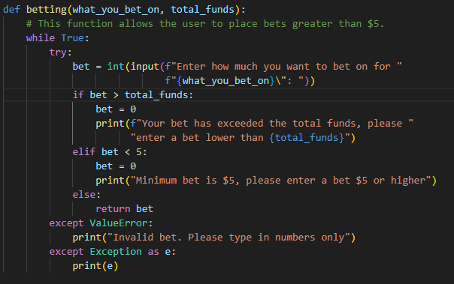
Betting() function
Uses a while loop set to True.
Asks the user to enter a bet less than total funds and greater than 5.
Catches ValueError.

Slide 15
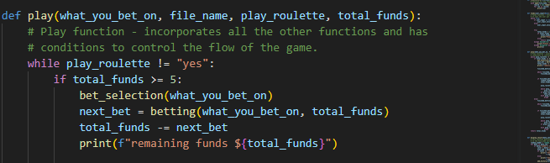
Play() Function
This function incorporates most of the other functions. It uses data returned from other functions.
Example is the ‘total_funds’ variable is subtracted by the ‘next_bet’ variable, which was assigned to the ‘betting()’ function.

Slide 16
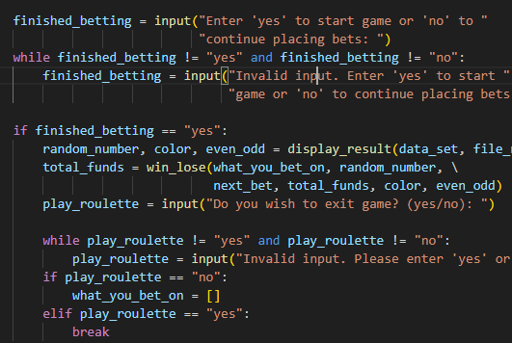
Play() function continued
After entering in your first bets, a prompt will come up, asking if you want to start game or continue betting.
Used a while loop to catch any other input other that ‘yes’ or ‘no’.
If ‘yes’ the game starts and the results are displayed and funds are calculated.
Another prompt is ask after the game, to see if the user wants to exit or continue playing. If they want to continue, the ‘what_you_bet_on’ variable is reset to empty.

Slide 17
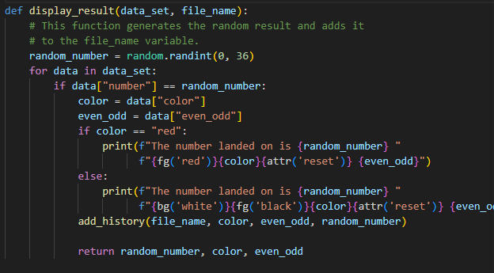
Display_result() function
Used the random module to generate random number.
Used a for loop to iterate through the ‘data_set’ variable, and matched it to the respective color and even/odd.
The ‘data_set’ variable contains a list of dictionaries with all the available numbers and data to bet on.

Slide 18
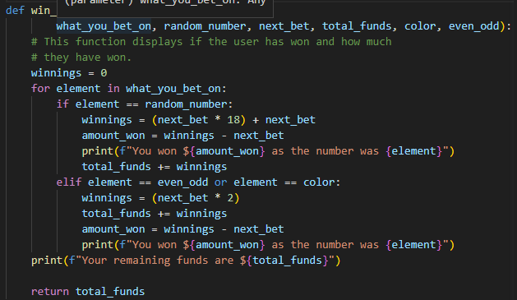
Win_lose() function
Uses a for loop to iterate through the ‘what_you_bet_on’ variable (list).
It matches it with the generated random number from the ‘display_result()’ function.
Then calculates amount won and displays the remaining funds.

Slide 19
Challenges from build process
Difficult to keep track of all the variables and where they change in the functions after calling the functions.
Trying not to write repeated code.
Favourite part:-
Completing the ‘play()’ function, as that was what tied everything together, and was the most difficult to make and keep track of.

Slide 20
Thank you for listening

